Slide 1
Analytical Services Internship
Complex Universe of DATA

Slide 2
DATA GROWTH might be
HIGHER then Bay Area
POPULATION GROWTH
For 54 years phrase Garbage In Garbage Out has been in existence…

Slide 3
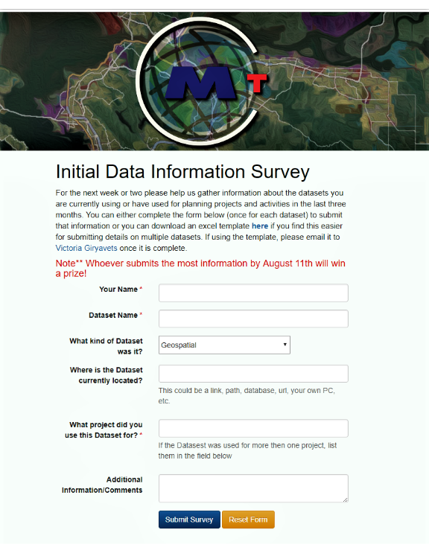
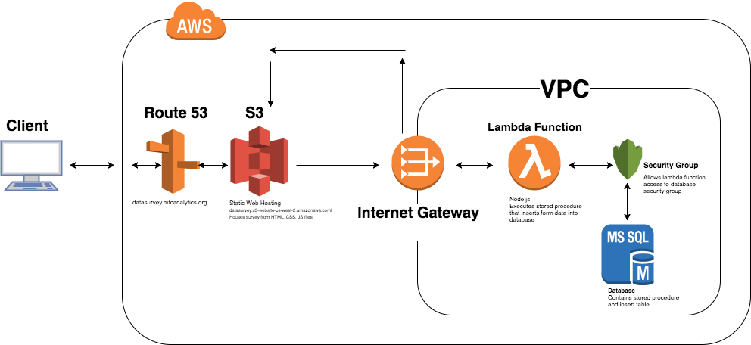
Investigation, or what is commonly know as “Gathering Business Requirements”

Slide 4
initial participation 28%
Web form/Excel Template
hunt for information
Email
In-Person Interview
“Drive-by”

Slide 5
High volume of existing data
Heavy volume of existing tasks
Low Priority
Skepticism
Lack of clarity in purpose
save half of a million dollars by doing thorough inventory of existing data

Slide 6
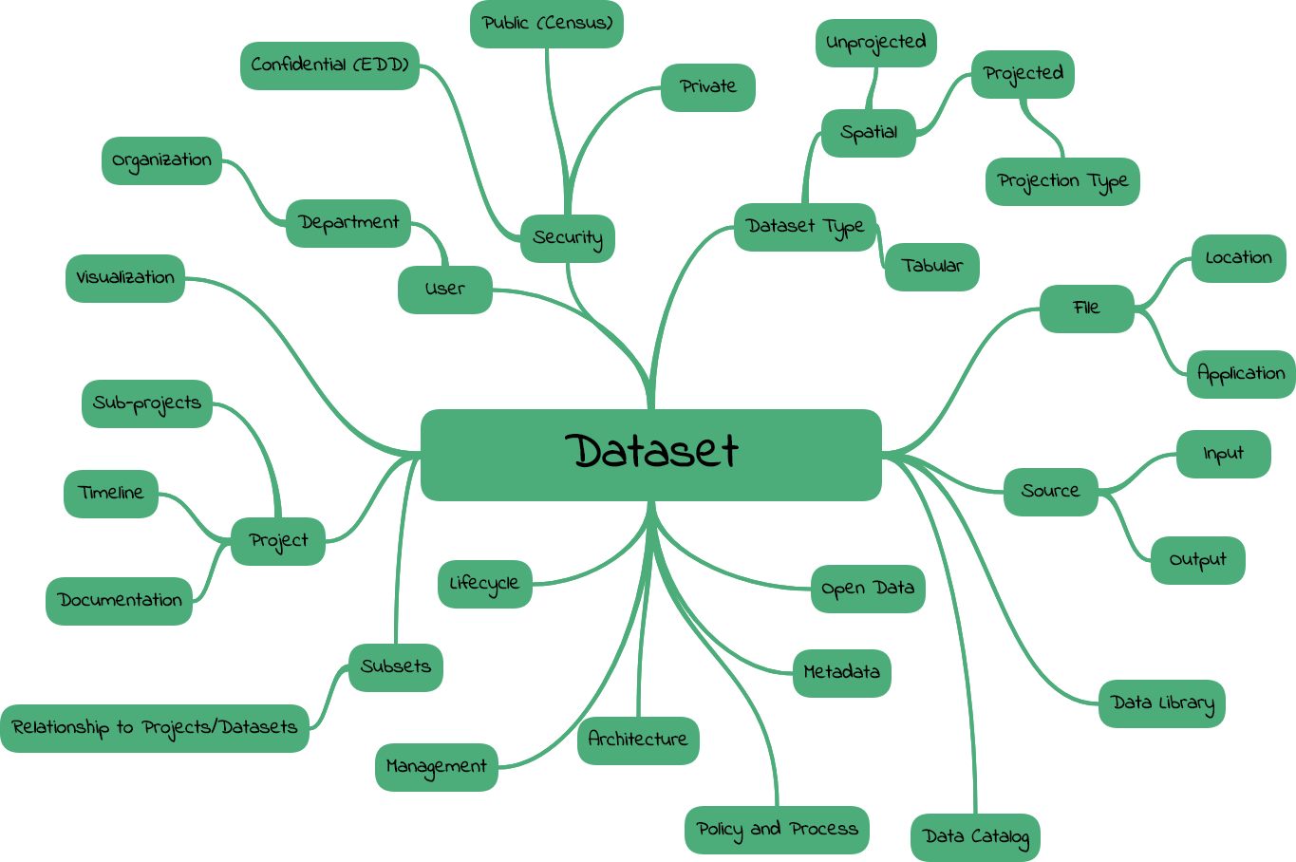

Slide 7
And over 100 MS Access databases…

Slide 8
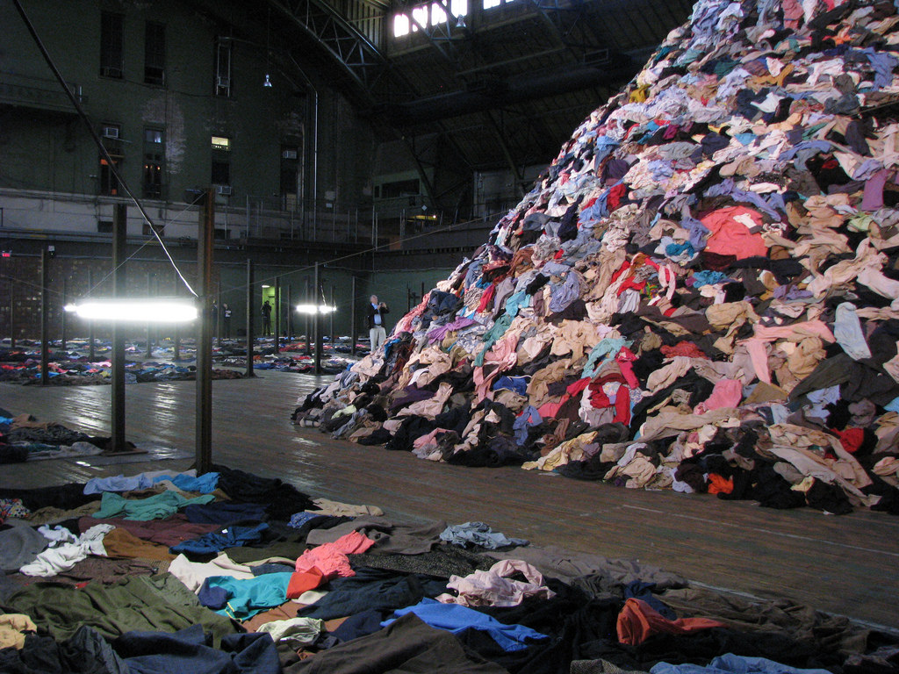

Closet Full of “Data”
Process

Slide 9
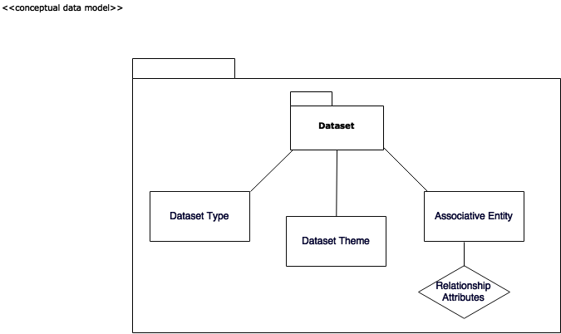
Started work on High Level Conceptual Design
With the time, availability and complexity

Slide 10
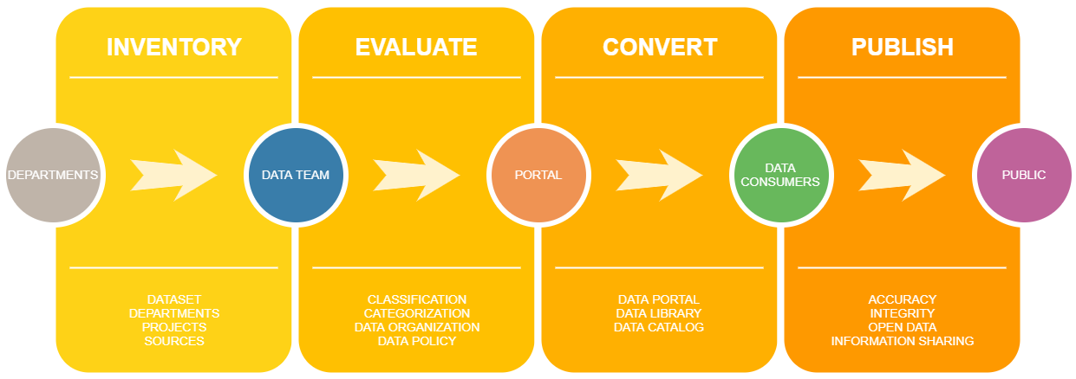
DONE
Gather business requirements
High Level Conceptual Data Model
TO DO
Develop a logical data model
Develop physical data model
Test Data model
Dataset Submission Form…..

Slide 11
Bay Area Metro Smart Data
Comprehensive Data Governance
Audit
Smart Data Tracking
and Publishing

